Slide 1
USDOL Office of Apprenticeship ESAC 2023

Slide 2
Vision - Office Of Apprenticeship
Registered Apprenticeship is an industry-driven pathway to successful careers that cultivates talent and reflects the diversity of the nation’s economy and people.
Notes:
Bernie

Slide 3
Mission - Office Of Apprenticeship
The Office of Apprenticeship promotes and oversees quality, accessible apprenticeship opportunities for workers seeking higher-skilled, higher-paying jobs and engages employers seeking to build a qualified, diverse, and inclusive workforce.
Notes:
Bernie

Slide 4
Core Values - Office Of Apprenticeship
Commitment
OA employees are committed to and passionate about supporting our sponsors in the design and development of the most effective and high quality apprenticeship programs while protecting the safety and welfare of apprentices.
Integrity
Accountability, equity, and trust; these define our daily operations and how we effectively and efficiently steward our public resources.
Diversity, Equity, Inclusion, Accessibility
We strive to create greater opportunity for underserved populations – valuing diversity, equity, inclusion, and accessibility - as a primary aspect of delivering on OA’s mission.
Quality Customer Service
Our technical assistance, products and services are responsive, timely, and designed with quality and continuous improvement. We go the extra mile to work with you to design world-class apprenticeship training opportunities.
Notes:
Bernie

Slide 5
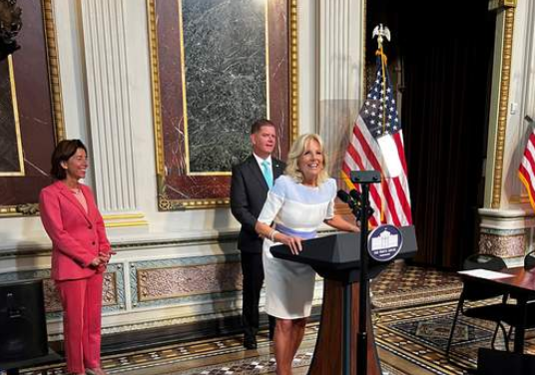
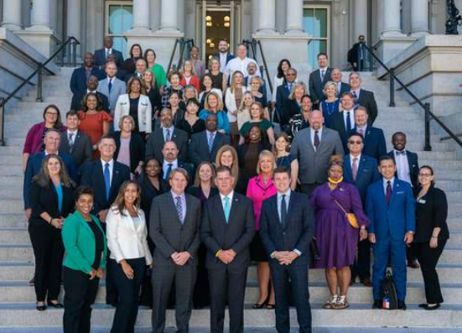
APPRENTICESHIP AMBASSADOR INITIATIVE
The Apprenticeship Ambassador Initiative is designed to create a national network of employers, labor organizations, industry associations, program sponsors, educators, workforce intermediaries, apprentices, community-based organizations, and other stakeholders to serve as champions for expanding and diversifying Registered Apprenticeship.
For more information check out the Apprenticeship Ambassador page on Apprenticeship.gov
Notes:
Secretary Walsh, in coordination with Vice President Kamala Harris, Ambassador Susan Rice, Governor Gretchen Whitmer, Mayor Randall Woodfin, Secretaries Gina Raimondo and Miguel Cardona, AFL-CIO President Elizabeth Schuler, Service Employees International Union President Mary Kay Henry, and Employers Siemens and CVS Health announced this new Apprenticeship Ambassador initiative on November 15, 2021 during National Apprenticeship Week in this announcement video.
NOTE: Image is hyperlinked
https://youtu.be/EEhHGL-9rgQ

Slide 6
PARTNER WITH DOL TO:
APPRENTICESHIP AMBASSADORS
Promote and expand awareness of the benefits of Registered Apprenticeship
Identify and scale innovative practices and partnerships
Increase access and support for underrepresented and underserved populations
Communicate the business case for Registered Apprenticeship as a mainstream workforce strategy

Slide 7
Apprenticeship Ambassador Commitments
The first cohort of 205 Apprenticeship Ambassadors, announced in July 2022, have existing Registered Apprenticeship programs in over 40 in-demand industries and have committed to expand and diversify these programs over the next year by collectively:
Developing 460 new Registered Apprenticeship programs across their 40 industries; and
Hiring over 10,000 new apprentices, and holding 5,000 outreach, promotional, and training events to help other business, labor, and education leaders launch similar programs.

Slide 8
CRITERIA TO
BECOME AN AMBASSADOR
Organization has Registered Apprenticeship (RA) program experience, which can include:
RA sponsor
RA RTI provider
RA Intermediary
Sponsor of pre-apprenticeship program that leads to a RA program
Office of Apprenticeship Contractor
Office of Apprenticeship Grantee
Previous ApprenticeshipUSA LEADER
Previous ACA member
Employer with RA program experience
Other RA experience (Workforce professional, RA partners, Researcher, etc.)
Organization has made a RA Commitment – at least one option chosen on application to promote Registered Apprenticeship.

Slide 9
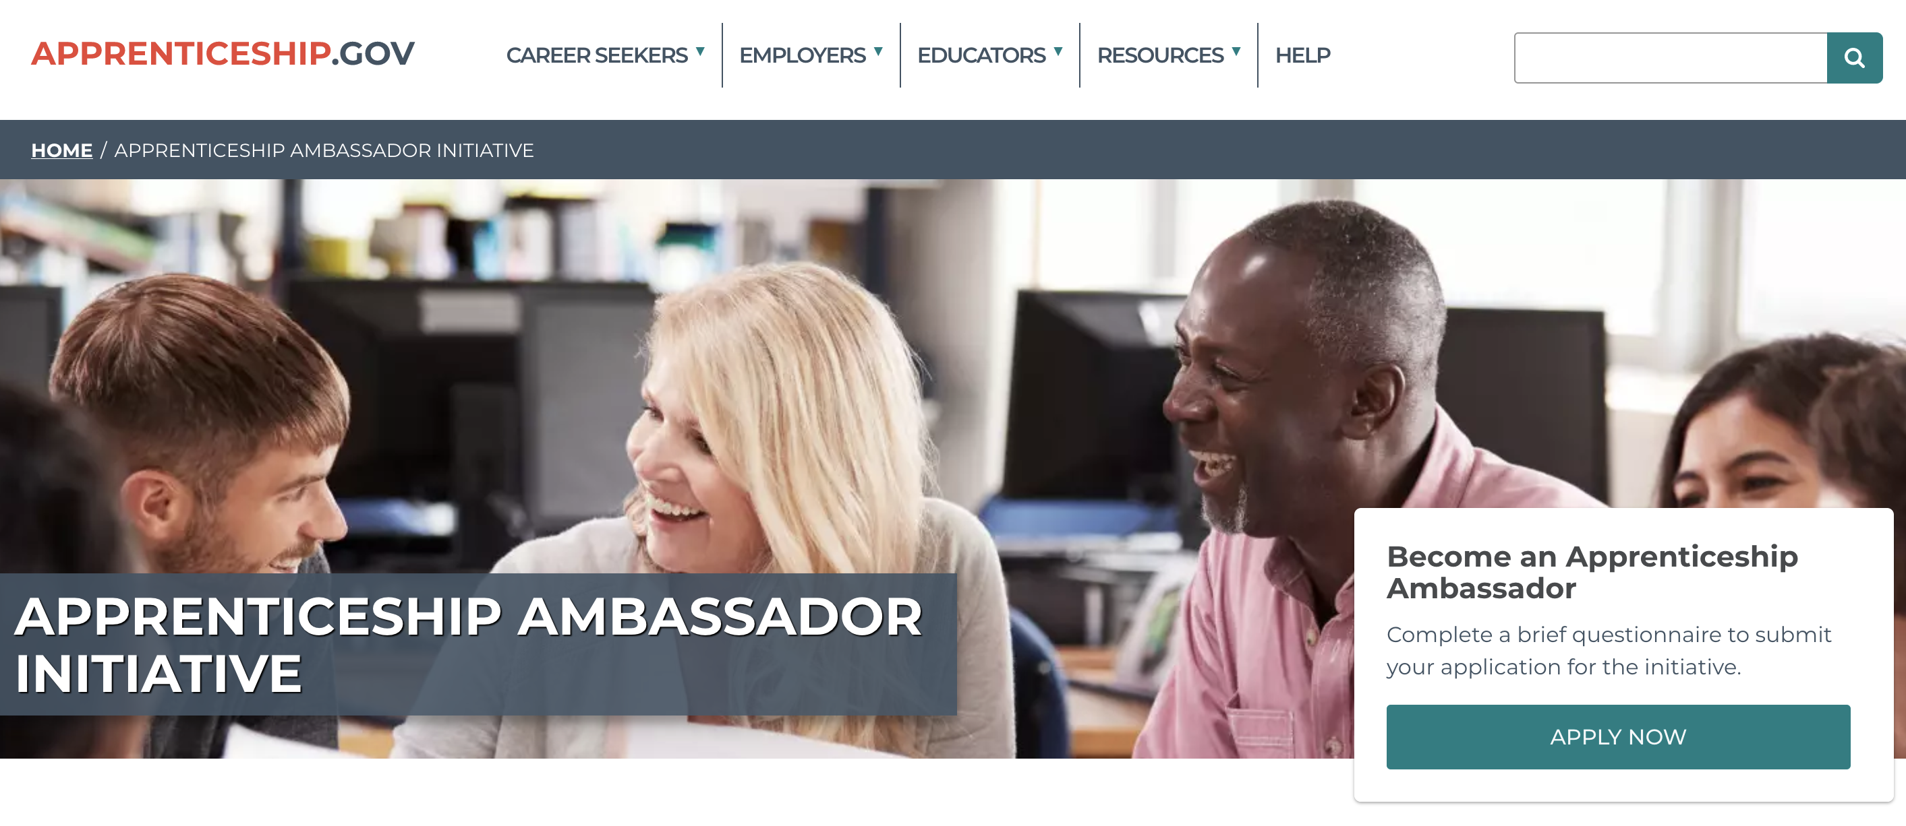
FOR THE AMBASSADOR INITIATIVE
HOW TO APPLY
RESOURCES:
Apprenticeship Ambassador Initiative website
Apprenticeship Ambassador Fact Sheet
ONLINE APPLICATION
Announcement of the next group of Ambassadors coming early 2023.

Slide 10
Apprentice Trailblazer Initiative
The Apprentice Trailblazer Initiative is designed to create a national network of diverse apprentices and apprenticeship graduates of all ages and backgrounds to feature their stories and hear their perspectives, show how Registered Apprenticeships increase opportunities for underserved populations, and bring awareness to other career seekers who may be interested in becoming apprentices.
Launching in 2023, our first cohort of Apprentice Trailblazers will include youth apprentices and recent youth apprenticeship graduates. Consider encouraging your top youth apprentices to apply.

Slide 11
APPRENTICE TRAILBLAZERS PARTNER WITH DOL TO:
Create a platform for apprentices/graduates to share their experiences and educate career seekers on the benefits of RA
Provide a professional development opportunity for apprentices/graduates
Increase support for underrepresented and underserved populations
Hear viewpoints from the apprentice perspective
Serve as champions to promote RA through outreach activities and collaboration
Create networking and mentorship opportunities for apprentices/graduates

Slide 12
CRITERIA TO
BECOME A TRAILBLAZER
The first cohort of Apprentice Trailblazers will focus on youth. Eligible applicants must:
Be a current youth apprentice (aged 16-24) in a Registered Apprenticeship program for at least 6 months or recent youth apprenticeship graduate within the past 3 years;
Be an apprentice/apprenticeship graduate from a Registered Apprenticeship program in good standing who has shown exemplary leadership, mentoring, teamwork, promotional activities, and/or has a transformative story as an apprentice;
For apprenticeship graduates, be currently working in an industry/occupation similar to your Registered Apprenticeship program;
Make a year-long commitment to promote Registered Apprenticeship.

Slide 13
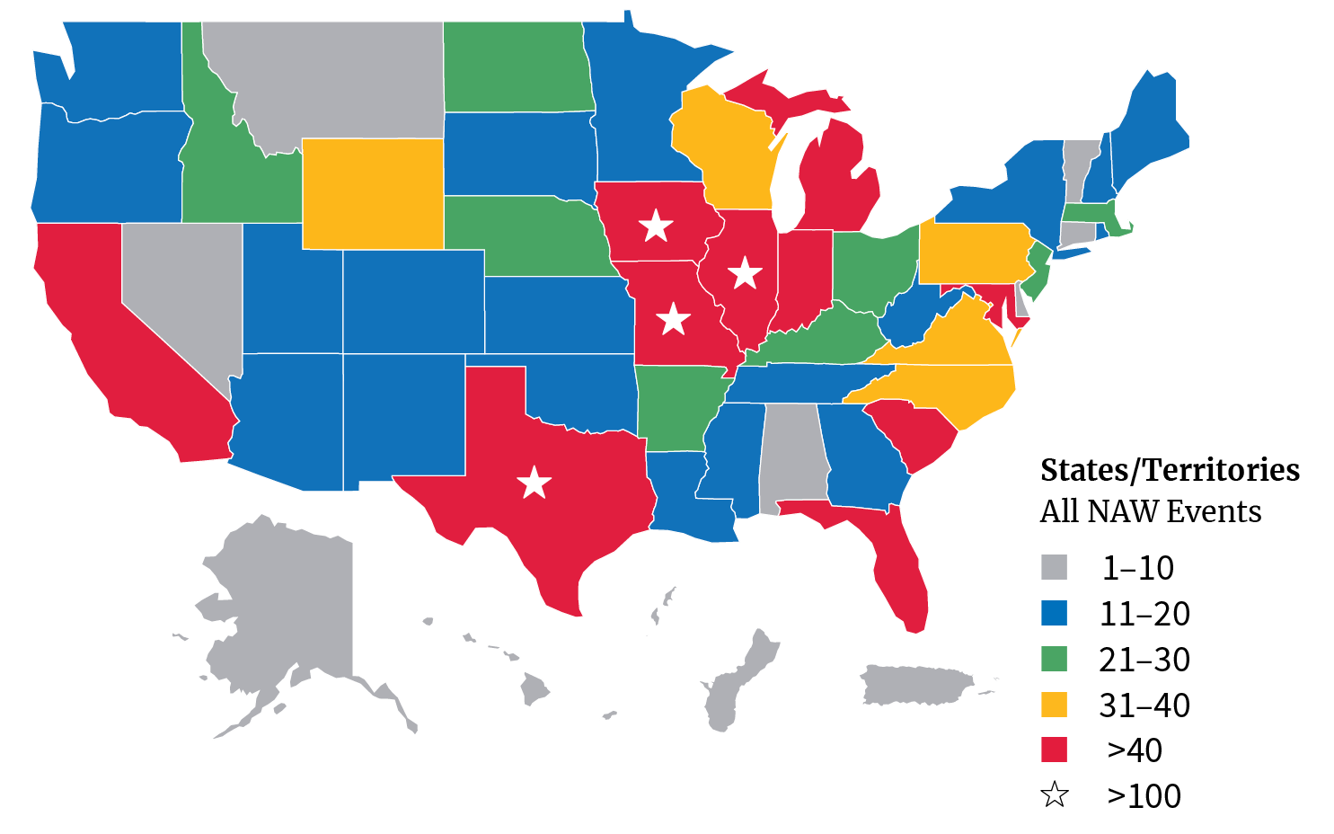
NATIONAL APPRENTICESHIP WEEK
NAW 2022 broke all previous records:
1,397 events took place across all 50 states!
371 proclamations: 255 from education & industry partners
The 9th Annual National Apprenticeship Week (NAW) will take place on November 13-19, 2023!
NAW is a nationwide celebration that brings together business leaders, career seekers, labor, educational institutions, and other critical partners to demonstrate their support for apprenticeship.
Get involved by hosting or attending an event or signing and submitting a proclamation!
Visit www.apprenticeship.gov/NAW for resources!

Slide 14
WHAT IS APPRENTICESHIPUSA?
ApprenticeshipUSA is a unifying brand designed to connect, unite, and amplify all stakeholders in the national Registered Apprenticeship system including apprenticeship sponsors, training providers, apprentices, Office of Apprenticeship staff, State Apprenticeship Agencies, employers, labor management organizations, industry associations, educators, equity partners, and others under one name.
This initiative supports the Department’s broader efforts to expand, diversify, strengthen, and modernize Registered Apprenticeship.
Notes:
Apprenticeships are a customizable, flexible, and proven business-driven model for developing workers.
By using an apprenticeship approach, businesses with skills gaps can take steps to ensure workers are trained to employer needs and gain the value of apprentices’ work during their training.

Slide 15
Apprenticeship.gov
https://www.apprenticeship.gov/
Highlights
Partner Finder
Job Finder
Universal Outreach tool
EEO
Resource Hub
Intermediary List and how to leverage
Investments Search feature

Slide 16
Registered Apprenticeship Infrastructure Resources
President Biden signed the Infrastructure Investment and Jobs Act, also known as the “Bipartisan Infrastructure Law”) into law on November 15, 2021. The Bipartisan Infrastructure Law is the largest long-term investment in our infrastructure and economy in our nation’s history. It provides $550 billion over the next five years in new federal investment in infrastructure, including in roads, bridges, mass transit, water infrastructure, resilience, and broadband. Registered Apprenticeship helps ensure skilled workers are being trained as projects are being delivered.
Learn more about utilizing Registered Apprenticeship to build our infrastructure and find infrastructure resources on our Infrastructure Resource Page on Apprenticeship.gov
Notes:
The Administration has made major investments through the American Rescue Plan (ARP), Bipartisan Infrastructure Law (BIL), CHIPS and Science Act (CHIPS), and Inflation Reduction Act (IRA) that will create new jobs in sectors vital to economic and national security such as advanced manufacturing, cybersecurity, climate resilience, and electrification.

Slide 17
Inflation Reduction Act Apprenticeship Resources
On August 16, 2022, President Biden signed Public Law 117-369, 136 Stat. 1818, commonly known as the Inflation Reduction Act of 2022 (IRA), into law. The IRA amended the Internal Revenue Code to add prevailing wage and Registered Apprenticeship requirements for taxpayers constructing, and in some case performing alteration or repair, of qualified clean energy facilities, property, projects, or equipment to qualify for increased tax credit or deduction amounts. The U.S. Department of Labor’s Office of Apprenticeship is committed to supporting the Department of the Treasury and the Internal Revenue Service in the effective implementation of these apprenticeship requirements.
Learn more: Inflation Reduction Act Apprenticeship Resources
Inflation Reduction Act Tax Credit
Notes:
OA has a dedicated mailbox for answering IRA-related apprenticeship questions: apprenticeshipira@dol.gov
You can increase access to RA for underrepresented populations by implementing quality pre-apprenticeship programs that served as on-ramps to RA
Apprentices’ earnings growth exceeded that of comparable workers not in apprenticeships regardless of race and ethnicity.​
Every $100 an employer invests in the registered apprenticeship program generates $144.30 in total benefits.

Slide 18
Regional and Field Offices
Committed to Quality and Integrity

Slide 19
Regional and Field Offices
The mission of the Regional Field Offices is to provide technical assistance to employers, State Apprenticeship Agencies (SAAs), and workforce intermediaries in designing a Registered Apprenticeship program, supporting implementation, and registering of apprentices, and in resolving any compliance issues that may emerge. Program compliance and quality review activities are conducted by Regional Offices to ensure the successful operation of high-quality programs that maintain the integrity of the Registered Apprenticeship system and Equal Employment Opportunity requirements.
Regional Field Offices conduct a wide variety of outreach and customer support activities to a broad range of groups, such as businesses, associations, organized labor, non-profit organizations, community colleges, WIOA-funded state and local workforce entities, ETA-funded discretionary grantees, and others focused on promoting and expanding use of Registered Apprenticeship. Conducting initial outreach with potential business customers and providing on-going support and assistance in establishing and building on those client relationships to achieving program development and registration of new apprentices are key functions of Regional Field Offices.
Regional Field Offices provide national leadership and specialized technical assistance OA-wide to support expansion of Registered Apprenticeship in a particular industry sector as part of the Sectors of Excellence in Apprenticeship (SEAs) initiative. As part of the SEAs initiative, Regional Offices provide leadership in working with Leaders of Excellence in Apprenticeship Development, Education and Research (LEADERs), industry, education, and other stakeholders to identify, design, and develop registered apprenticeship programs for established and emerging occupations in an assigned industrial sector.
Notes:
Jim – 5 minutes

Slide 20
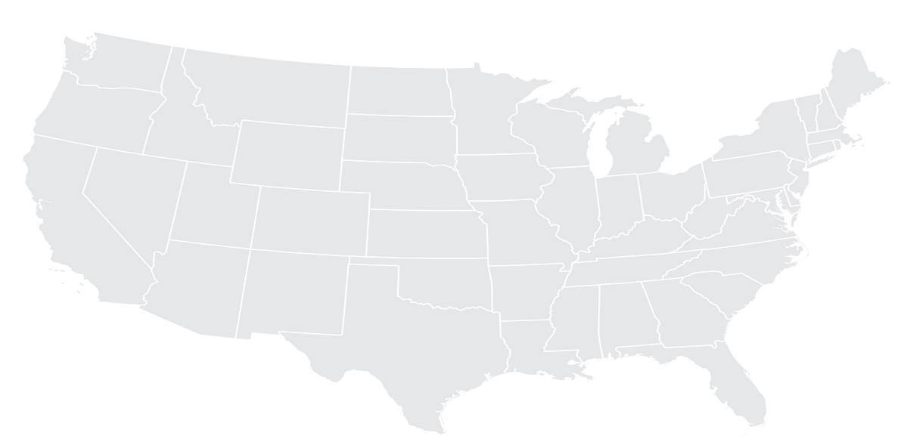
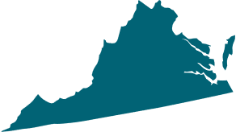
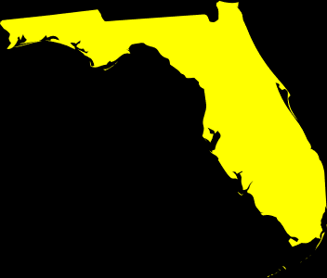
OA Regional Offices
Region 5
Chicago, IL
Region 1
Boston, MA
Region 2
Philadelphia, PA
Region 6
San Francisco, CA
Region 3
Atlanta, GA
Region 4
Dallas, TX
National Program | Num App​ | Num Prog​
 | 140796 | 324
Notes:
Dudley – 5 minutes

Slide 21
Region 1
Regional Director: Bernard Treml, III
Deputy Regional Director: Charlie McNeil
Special Initiatives/Industries
Care Industry
Health Care
Education (Teachers)
Financial Services Industry
Conducted 331 Reviews and 41 EAPR’s
Working with other Federal and State Agencies to promote DEIA
Provide Foundational & EEO Training to our SAA Partners
Region 5
Chicago, IL
Region 1
Boston, MA
OA | SAA
New Hampshire | Connecticut
New Jersey | Maine
Puerto Rico | New York
 | Rhode Island
 | Vermont
 | U.S. Virgin Islands
Region 2
Philadelphia, PA
Region 6
San Francisco, CA
Region 3
Atlanta, GA
Num App​ | Num Prog​
46468​ | 4582​
Region 4
Dallas, TX
Numbers in regions are OA/SAA combined
Notes:
Bernie – 5 minutes

Slide 22
Region 2
Regional Director: Jim Foti
Deputy Regional Director: Dawn Lynch
Special Initiatives/Industries
Federal Agency Apprenticeship
Hospitality
Region 5
Chicago, IL
Region 1
Boston, MA
OA | SAA
West Virginia | Delaware
 | Maryland
 | Pennsylvania
 | Virginia
 | Washington, D.C.
Region 2
Philadelphia, PA
Region 6
San Francisco, CA
Region 3
Atlanta, GA
Num App​ | Num Prog​
53910​ | 3431​
Region 4
Dallas, TX
Numbers in regions are OA/SAA combined
Notes:
Jim – 5 minutes

Slide 23
Region 3
Regional Director: Garfield Garner
Deputy Regional Director: Bill Kraus
Special Initiatives/Industries
Transportation
Agriculture
Minority Serving Institutions
Region 5
Chicago, IL
Region 1
Boston, MA
OA | SAA
Georgia | Alabama
Mississippi | Florida
South Carolina | Kentucy
 | North Carolina
 | Tennessee
Region 2
Philadelphia, PA
Region 6
San Francisco, CA
Region 3
Atlanta, GA
Num App​ | Num Prog​
58051​ | 3412​
Region 4
Dallas, TX
Numbers in regions are OA/SAA combined
Notes:
Garfield – 5 minutes

Slide 24
Region 4
Regional Director: Dudley Light
Deputy Regional Director: Troy Johnson
Special Initiatives/Industries
Energy\Construction
Minority Serving Institutions
Tribal Nations
Region 5
Chicago, IL
Region 1
Boston, MA
OA | SAA
Arkansas | Louisiana
Colorado* | Montana
Oklahoma | New Mexico
Texas
Wyoming
North Dakota
South Dakota
Utah
Region 2
Philadelphia, PA
Region 6
San Francisco, CA
Region 3
Atlanta, GA
Region 4
Dallas, TX
Num App​ | Num Prog​
55563​ | 2983​
Numbers in regions are OA/SAA combined
Notes:
Dudley – 5 minutes

Slide 25
Region 5
Regional Director: Dean Guido
Deputy Regional Director: Carmela West
Special Initiatives/Industries
Advanced Manufacturing
Financial Services Industry
Region 5
Chicago, IL
Region 1
Boston, MA
OA | SAA
Iowa* | Kansas
Illinois | Minnesota
Indiana | Ohio
Missouri | Wisconsin
Michigan
Nebraska
Region 2
Philadelphia, PA
Region 6
San Francisco, CA
Region 3
Atlanta, GA
Num App​ | Num Prog​
118522​ | 5531​
Region 4
Dallas, TX
Numbers in regions are OA/SAA combined
Notes:
Dean – 5 minutes

Slide 26
Region 6
Regional Director: Patricia Garcia
Deputy Regional Director: Aaron Wall
Special Initiatives/Industries
Information Technology/Cybersecurity
Telecommunications
Agriculture
Region 5
Chicago, IL
Region 1
Boston, MA
OA | SAA
Alaska | Arizona
California | Guam
Idaho | Nevada
American Samoa | Oregon
Northern Mariana Islands (CNMI) | Washington
Three "Freely Associated" nations: Palau, Micronesia, Marshall Islands | Hawaii
Region 2
Philadelphia, PA
Region 6
San Francisco, CA
Region 3
Atlanta, GA
Region 4
Dallas, TX
Num App​ | Num Prog​
113721​ | 2160​
Numbers in regions are OA/SAA combined
Notes:
Patty – 5 minutes

Slide 27
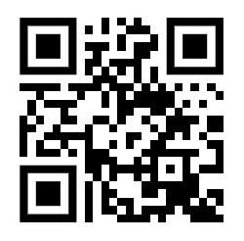
Thank You For Joining us Today!
Any Questions?
The Office of Apprenticeship is here to help!
Contact us at: apprenticeship@dol.gov
Or Visit: www.apprenticeship.gov

